Slide 1
ADEB: Attribute-Driven Edge Bundling
for General Graphs
with Applications in Trail Analysis
Vsevolod Peysakhovich, Christophe Hurter, Alexandru Telea

Slide 2
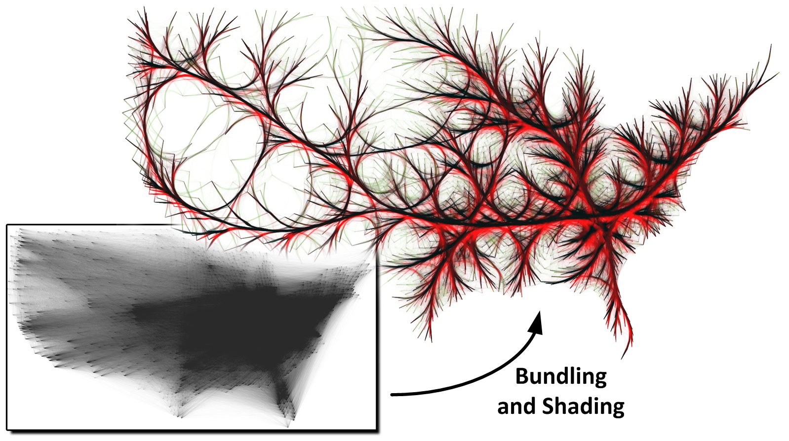
Edge bundling techniques trade clutter for overdraw by routing related edges along similar paths [1].
[1] Christophe Hurter, Ozan Ersoy, Alexandru Telea. Graph Bundling by Kernel Density Estimation. EuroVis 2012
Notes:
Classic bundling
Grouping edges according their spatial position
Heterogeneous values of attributes (direction, timestamp, weight etc.) are bundled together
But! Reasoning about such attributes is essential, especially in trail analyses

Slide 4
ADEB design rationale
KDEEB: Edges are attracted toward dense neighborhood
ADEB: Edges are attracted toward dense and compatible neighborhood
How make the compatibility criteria scalable?

Slide 5
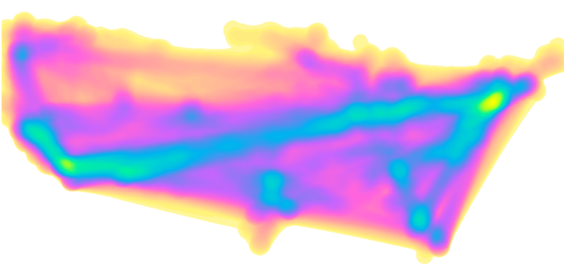
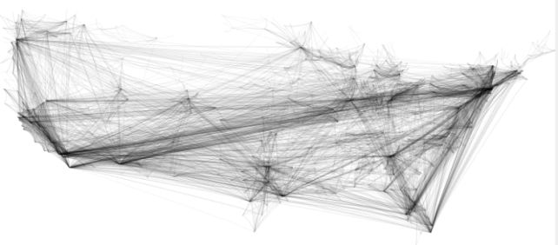
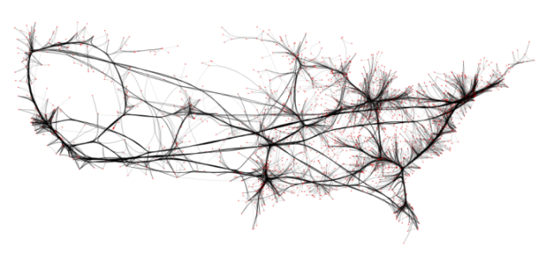
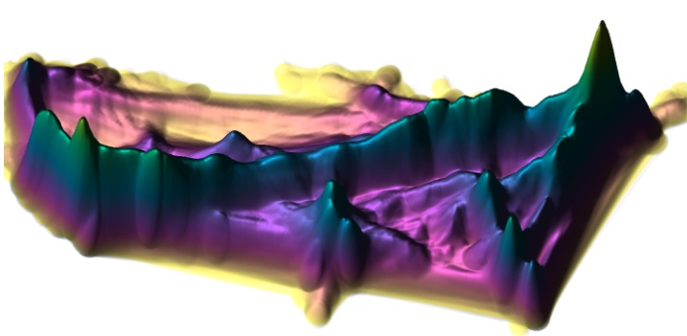
KDEEB : Mean Shift and Bundling*
sharpening
edge density signal
unbundled graph
bundled graph
If bundling sharpens the edge density, then
sharpening the edge density should bundle
*Christophe Hurter, Ozan Ersoy, Alexandru Telea. Graph Bundling by Kernel Density Estimation. (EuroVis 2012). Computer Graphics Forum 31, 3pt1 (june 2012) p865-874.
Notes:
For the one of you that know image processing, note that what we are doing is nothing else than men shift segmentation technique but on pixel color, but on edges
Bundling
Mean shift : Dorin Comaniciu, peter Meer

Slide 6
Edge Density (convolution)
Edge Advection
Direction Compability
Notes:
Kernel K (parabolic function) with a bandwith H
Mathemitacal formulation of the kenerl desity estimation
Delta is the gradient
H(t) is a factor that descreseas over time (less movements)

Slide 7
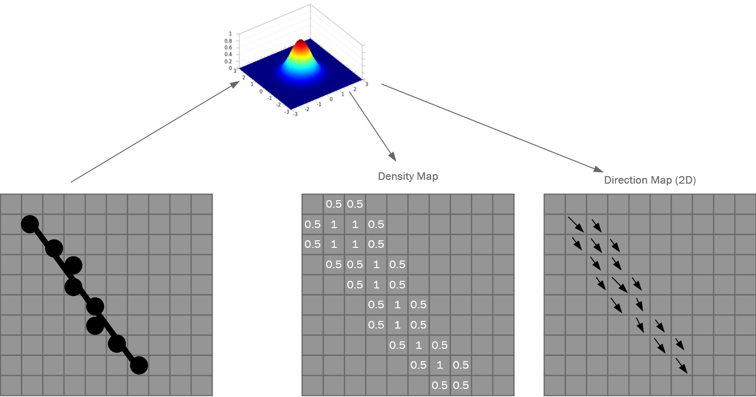

Slide 9
Generalized bundling
Notes:
Now we can easily use other edge attributes: a simple transformation of a number into a vector using polar coordinates

Slide 11
Air Traffic Visualization Use-case

Slide 14
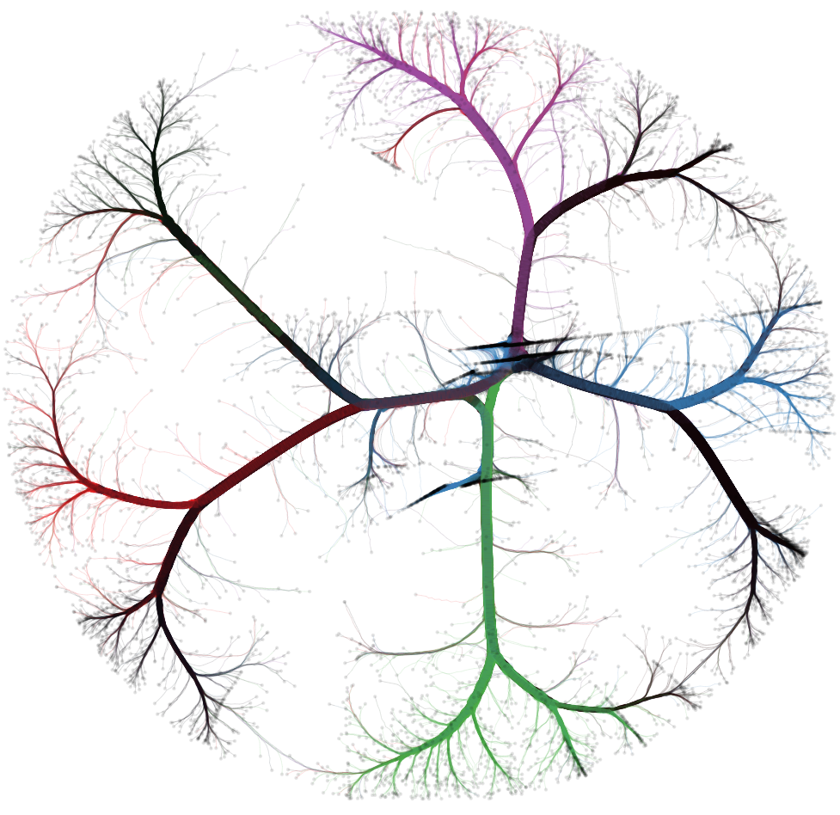

Slide 16
Gaze Visualization Use-Case

Slide 17
Raw Data

Slide 18
Direction

Slide 19
Time

Slide 20
Direction and Time

Slide 21
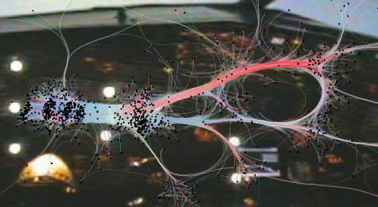
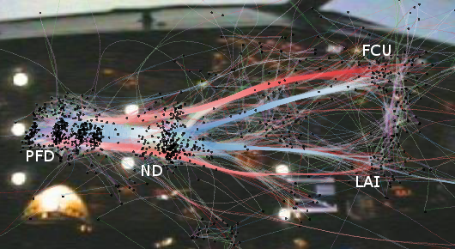
Raw Data
KDEEB
ADEB

Slide 22
Complexity same than KDEEB
The most prominent bundling techniques using edge compatibility measures (beyond edge distance) are FDEB [1, 2].
Both have a complexity of O(E C) where E is the number of edges in the input graph, and C the number of edge sampling-points.
Our method, just as KDEEB [3], is O(C).
2
[1] D. Holten and J. J. van Wijk. Force-directed edge bundling for graph visualization. CGF, 28(3):670–677, 2009.
[2] D. Selassie, B. Heller, and J. Heer. Divided edge bundling for directional network data. IEEE TVCG, 19(12):754–763, 2011.
[3] C. Hurter, O. Ersoy, and A. Telea. Graph bundling by kernel density
estimation. CGF, 31(3):435–443, 2012.

Slide 23
Performance Implementation C# and OpenGL 1.1, 2.3 GHz
US Airline Dataset : 2101 edges and 205 nodes
FDEB takes 19 seconds, with 12 sample-points/edge on average (25K total sampling points)
[1] takes 24 seconds, for a sampling of up to 25 points/edge (75K total sampling points)
KDEEB takes 0.5 seconds, with 86K sampling points.
ADEB takes 1.3 seconds, with 86K sampling points.
Overall, ADEB is roughly twice as slow as the undirected KDEEB, but about 18 times faster than the directional method in [40].
[1] D. Selassie, B. Heller, and J. Heer. Divided edge bundling for directional network data. IEEE TVCG, 19(12):754–763, 2011.
[2] C. Hurter, O. Ersoy, and A. Telea. Graph bundling by kernel density estimation. CGF, 31(3):435–443, 2012.
Notes:
with the conclusion that the method is highly SCALABLE as compared to other methods on the market! This is an important point, which we should emphasize!

Slide 24
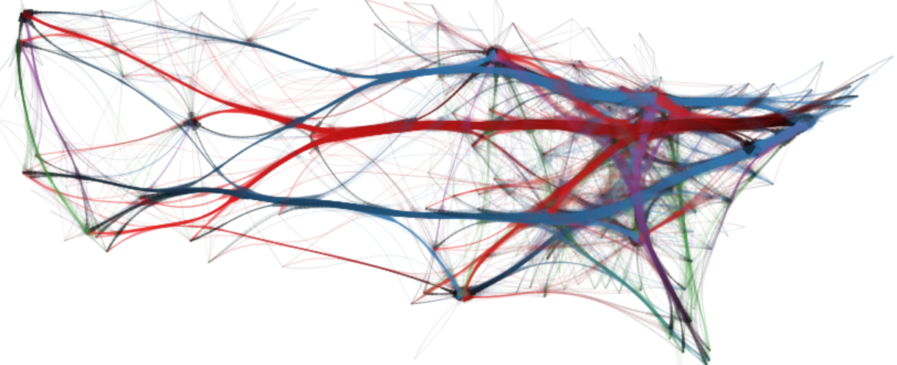
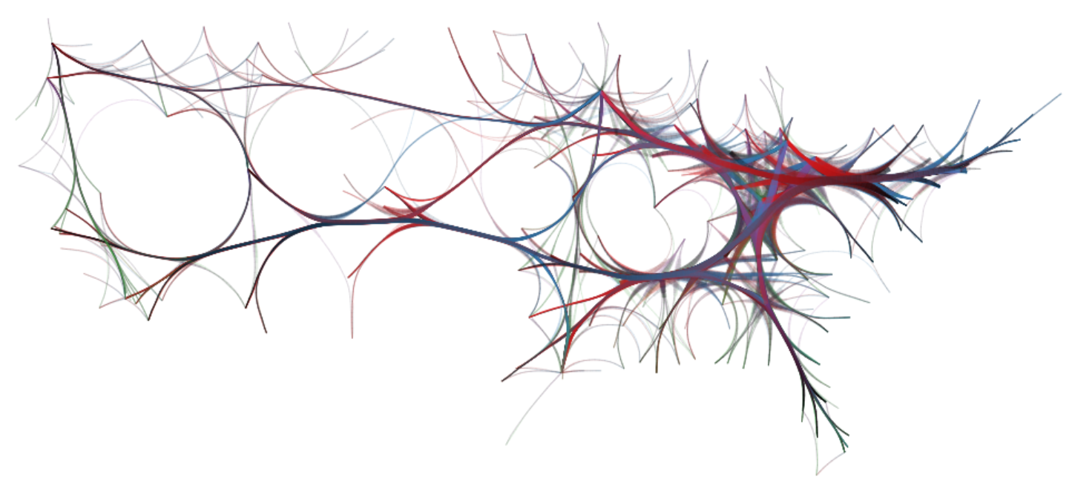
ADEB
KDEEB

Slide 25
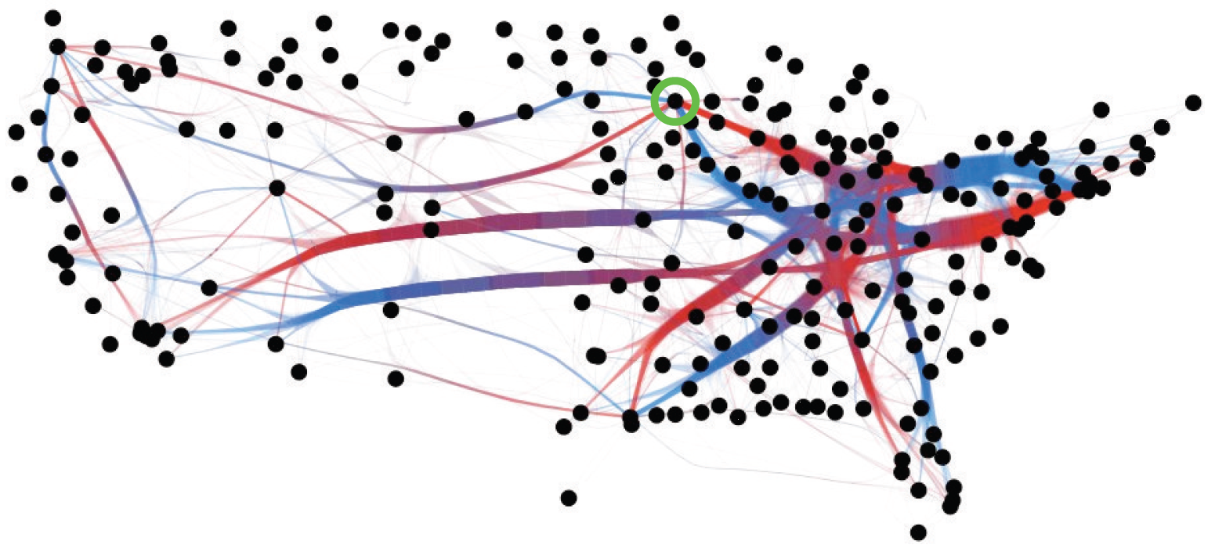
ADEB
FDEB + Direction

Slide 26
Summary of contributions
ADEB is a bundling algorithm that creates edge bundles from attributed graphs where edge compatibility can be defined by one or several attributes.
ADEB is fast, simple to implement, scalable, generic, and could be easily extended to handle dynamic graphs.
Future work
Refined compatibility metrics
Explore new dynamic datasets (DTI fibers)
Better spot specific patterns (design space)

Slide 27
ADEB: Attribute-Driven Edge Bundling
for General Graphs
with Applications in Trail Analysis
Vsevolod Peysakhovich, Christophe Hurter, Alexandru Telea

Slide 28
Size Artefacts

Slide 29
KDEEB Assets
Continuity (iteration = bundling strength)
Stability : mean shift[1] converges
Simplicity and speed
Implicit design
Conclusion:
KDEEB is ideal for bundling changing graphs
- Mouse bundling demo -
[1] D. Comaniciu and P. Meer. Mean shift: A robust approach toward feature
space analysis. IEEE TPAMI, 24(5):603–619, 2002.
Notes:
But the most important thing is the implicit design:
KDEEB can bundle, at a step, any graph (set of curves, actually) you plug into the method!
We don't need edge-correspondences (for KDEEB, that is, to work), or some preprocessing of the full sequence in advance, or clustering, or whatever:
we just bundle a set of curves.
So the key idea for bundling streaming graphs will be to LET THE BUNDLING-TIME (ITERATION) AND THE PHYSICAL TIME BE THE SAME.
most other bundling methods cannot do this.
Then, after you explain this, you can pass to slide 11, where you say something like "OK, so we have this observation that KDEEB seems ideally suited to bundle dynamic graphs; before we show how we do this, let's examine what kinds of dynamic graphs are out there; we identify two types of graphs... etc etc".

Slide 30
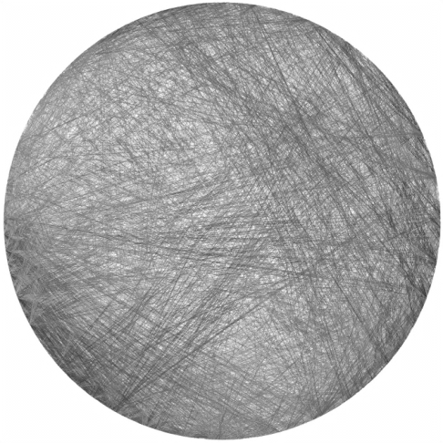
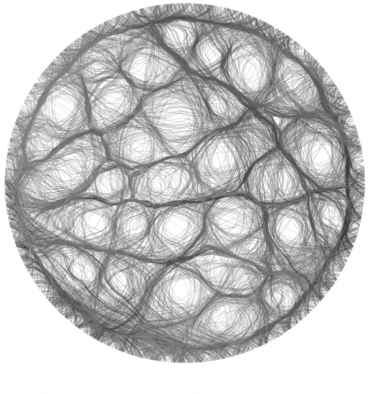
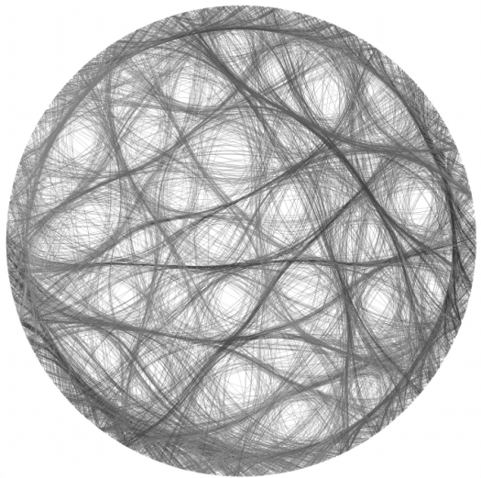
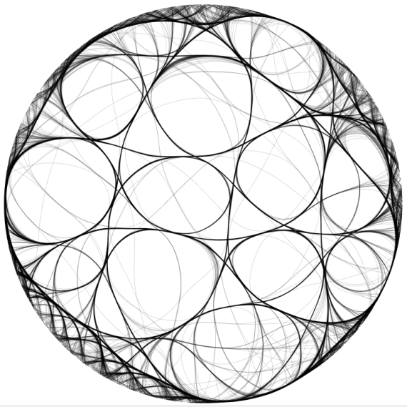
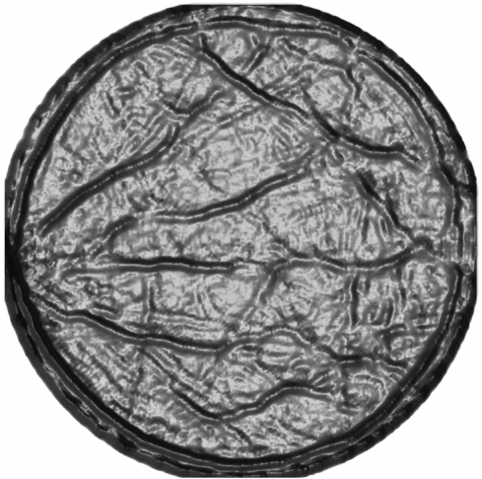
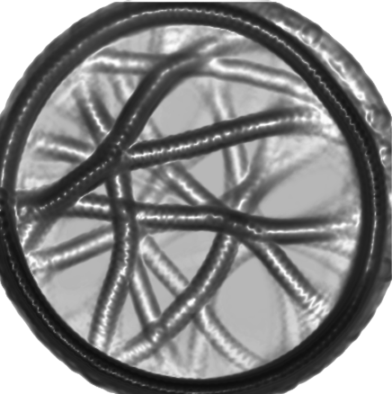
KDEEB pipeline
Notes:
Three main steps

